Slide 1
Footprinting, Reconnaissance & Network Scanning
• Cybersecurity | 5th Semester
• Concepts • Methodology • Defensive interpretation • Authorized lab
CYBERSECURITY • SEMESTER 5 01 / 21

Slide 2
Learning outcomes
• Distinguish passive and active reconnaissance.
• Explain how DNS, web metadata and public sources expose attack surface.
• Plan a scoped network scan and interpret host, port and service results.
• Prioritize findings and communicate limitations ethically.
CYBERSECURITY • SEMESTER 5 02 / 21

Slide 3
Where these activities fit
• Reconnaissance: gather information about a target environment.
• Scanning: test reachability, discover services and characterize exposure.
• Enumeration: obtain more detailed information about identified services.
• Assessment: validate weaknesses, determine impact and recommend controls.
• These phases overlap; discovery does not prove compromise.
CYBERSECURITY • SEMESTER 5 03 / 21

Slide 4
Footprinting: definition and objectives
• Footprinting is collecting information about an organization's systems, people, domains and technologies.
• Objectives: understand external attack surface, identify assets, map dependencies and expose unintended disclosures.
• Typical outputs: domain inventory, IP ranges, DNS records, technology clues and evidence log.
CYBERSECURITY • SEMESTER 5 04 / 21

Slide 5
Passive vs active reconnaissance
• Passive: uses already-published information; typically no direct probes to the target infrastructure.
• Examples: public websites, search results, certificate transparency and public code repositories.
• Active: interacts with target-controlled systems, e.g., DNS queries, HTTP requests and port probes.
• Active methods can generate logs, alarms or operational impact; obtain authorization.
CYBERSECURITY • SEMESTER 5 05 / 21

Slide 6
Public information sources
• WHOIS/RDAP: registrar and registration metadata, subject to privacy limits.
• DNS: A/AAAA, MX, NS, TXT and CNAME records reveal services and integrations.
• Certificate transparency: historical and current certificate names can reveal subdomains.
• Public documentation, job postings and repositories may reveal technology stacks.
• Cross-check timestamps: public data may be stale or misleading.
ICANN Lookup – WHOIS (Web interface)
Link : Whois pknic.net.pk (for PK website)
CYBERSECURITY • SEMESTER 5 06 / 21

Slide 7
DNS reconnaissance: reading records
• A/AAAA → IPv4/IPv6 addresses; CNAME → alias to another hostname.
• MX → mail routing; NS → authoritative nameservers; TXT → policy/verification data.
• Example: dig example.com MX ; dig example.com TXT (dig is service)
on windows try these commands bcz dig is not available
nslookup -type=MX example.com
nslookup -type=TXT example.com
• Do not assume that a discovered hostname is in scope or that its owner is the same as the parent domain.
CYBERSECURITY • SEMESTER 5 07 / 21

Slide 8
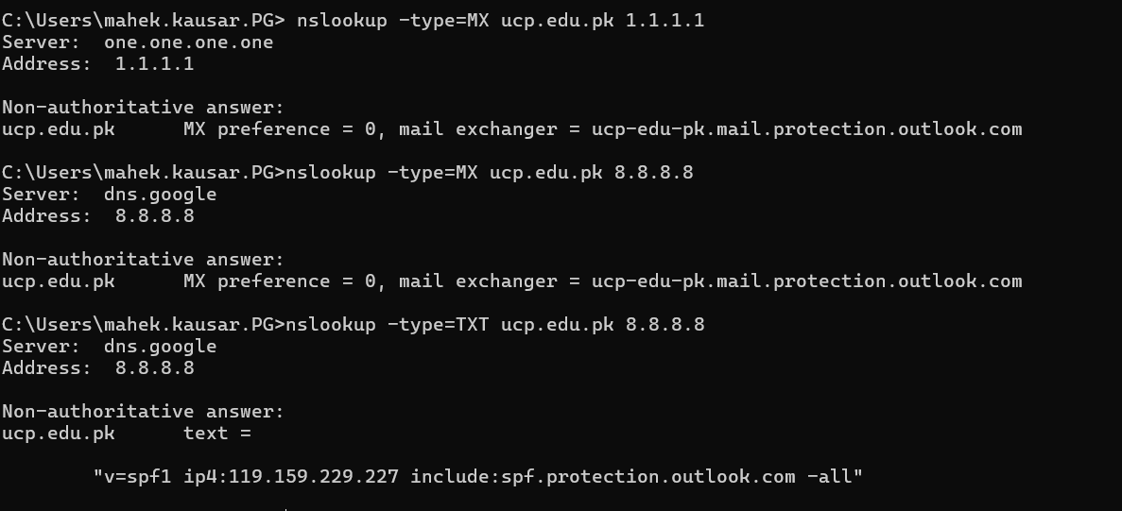
DNS reconnaissance: reading records
CYBERSECURITY • SEMESTER 5 07 / 21

Slide 9
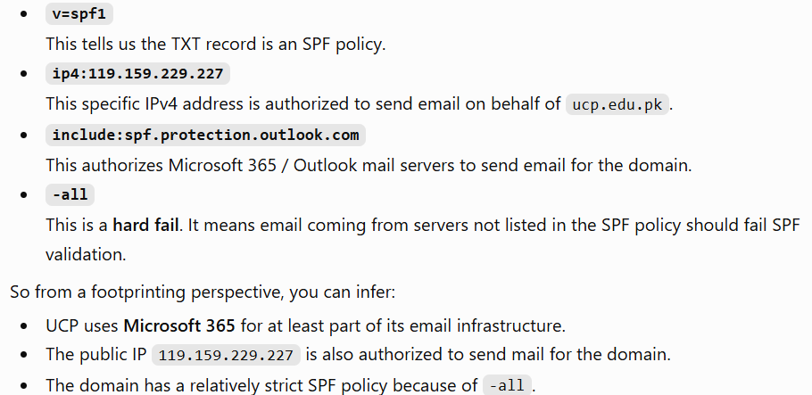
DNS reconnaissance: reading records
CYBERSECURITY • SEMESTER 5 07 / 21

Slide 10
OSINT quality and validation
• Record source URL, collection date, observed value and confidence.
• Separate facts ('DNS returned X') from inferences ('X may host email’).
Example:
Fact: MX record points to mail.protection.outlook.com
Inference: The organization may be using Microsoft 365
• Correlate independent sources; note CDN, cloud and shared-hosting ambiguity.
• Respect privacy and avoid collecting personal information unnecessarily.
Note; A CDN is a distributed network of servers that delivers web content closer to users while improving speed, availability, and security.
CYBERSECURITY • SEMESTER 5 08 / 21

Slide 11
Reconnaissance workflow
• 1. Define authorized scope and purpose.
• 2. Gather passive data and build an asset hypothesis.
• 3. Resolve names and validate ownership.
• 4. Identify exposed services through permitted active checks.
• 5. Document findings, uncertainty and defensive recommendations.
CYBERSECURITY • SEMESTER 5 09 / 21

Slide 12
Reconnaissance workflow
• 1. Define authorized scope and purpose.
• 2. Gather passive data and build an asset hypothesis.
• 3. Resolve names and validate ownership.
• 4. Identify exposed services through permitted active checks.
• 5. Document findings, uncertainty and defensive recommendations.
CYBERSECURITY • SEMESTER 5 09 / 21

Slide 13
Network scanning: key concepts
• Host discovery: determine whether a device responds to selected probes.
• Port scanning: infer whether a transport port is open, closed or filtered.
• Service/version detection: estimate application identity from responses.
• OS detection: infer platform from network characteristics; results may be uncertain.
• Vulnerability assessment is a separate step beyond basic scanning.
CYBERSECURITY • SEMESTER 5 10 / 21

Slide 14
TCP and UDP scanning
• TCP connection scan completes a connection attempt; generally easy to understand and log.
• SYN scan examines TCP handshake behavior and often needs elevated privileges.
nmap -sT TARGET_IP (TcP Scan)
sudo nmap -sS TARGET_IP (SYN scans often require administrator/root privileges because they need lower-level packet access.)
• UDP scans are slower and frequently ambiguous due to missing responses.
• Firewalls, rate limiting, NAT and middleboxes can change observations.
CYBERSECURITY • SEMESTER 5 11 / 21

Slide 15
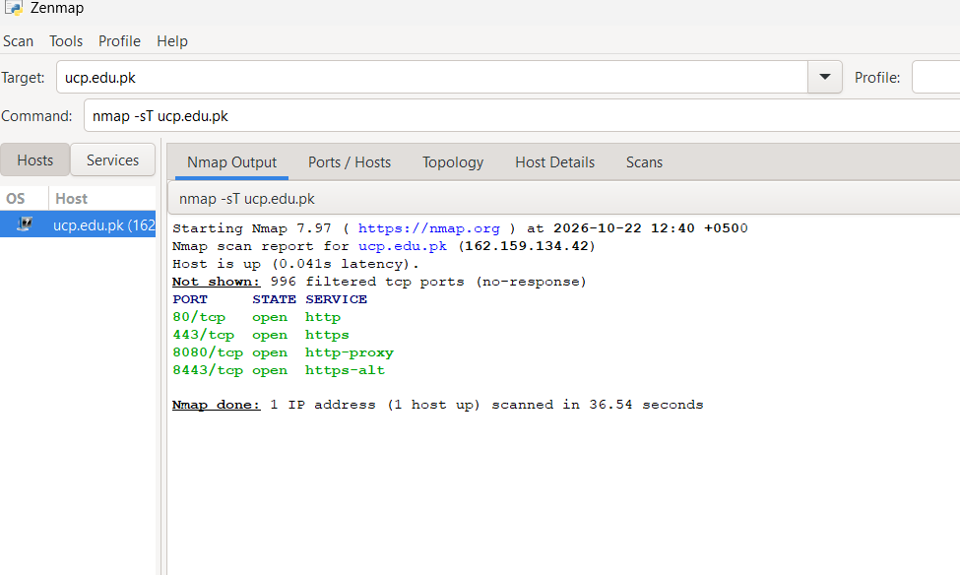
TCP and UDP scanning
CYBERSECURITY • SEMESTER 5 11 / 21

Slide 16
Interpreting Nmap states
• open: application is accepting connections on the scanned port.
• closed: host reachable but no service is listening on that port.
• filtered: probe response blocked or inconclusive due to filtering.
• open|filtered: scanner cannot distinguish open from filtered with available evidence.
• A port state describes a probe result, not overall system security.
CYBERSECURITY • SEMESTER 5 12 / 21

Slide 17
Nmap commands for a permitted lab
• nmap -sT -p 22,80,443 192.0.2.10 → targeted TCP connection scan.
• nmap -sV --version-light -p 80,443 192.0.2.10 → service/version hints.
• nmap -sn 192.0.2.0/29 → host discovery in a small authorized range.
• 192.0.2.0/24 is a documentation network: replace with instructor-provided lab addresses.
• Run only against systems you own or have written permission to assess.
CYBERSECURITY • SEMESTER 5 13 / 21

Slide 18
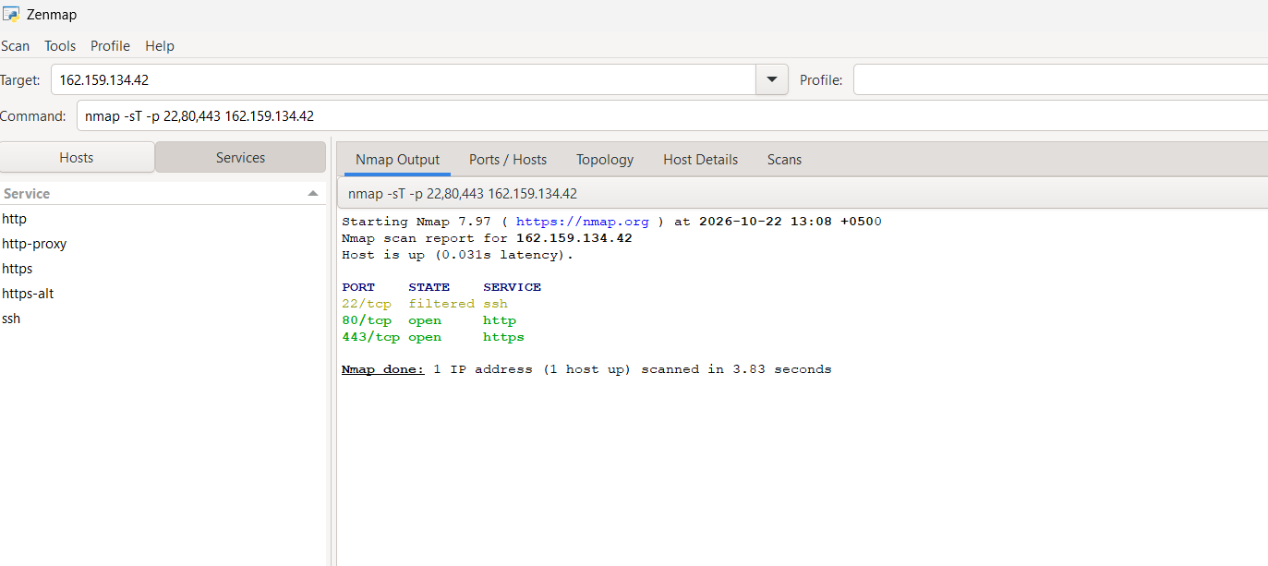
Tcp respose
CYBERSECURITY • SEMESTER 5 13 / 21

Slide 19
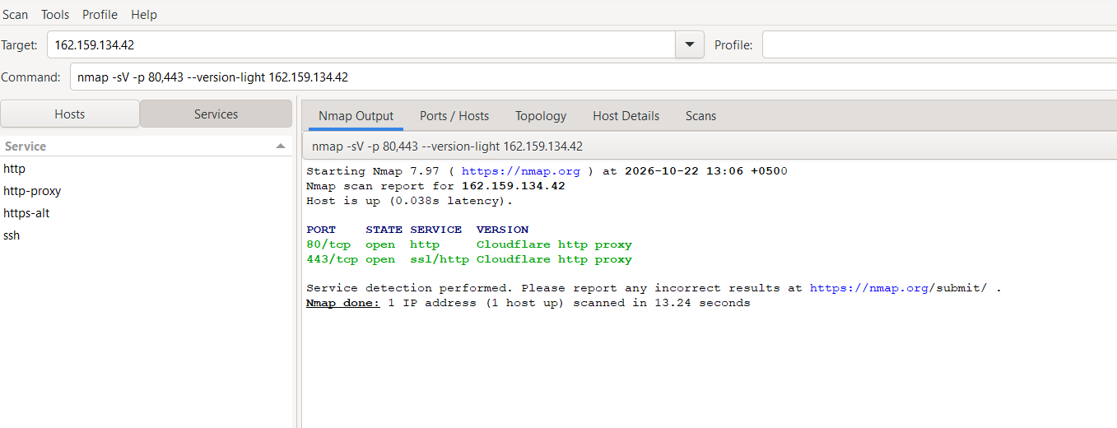
Services running
CYBERSECURITY • SEMESTER 5 13 / 21

Slide 20
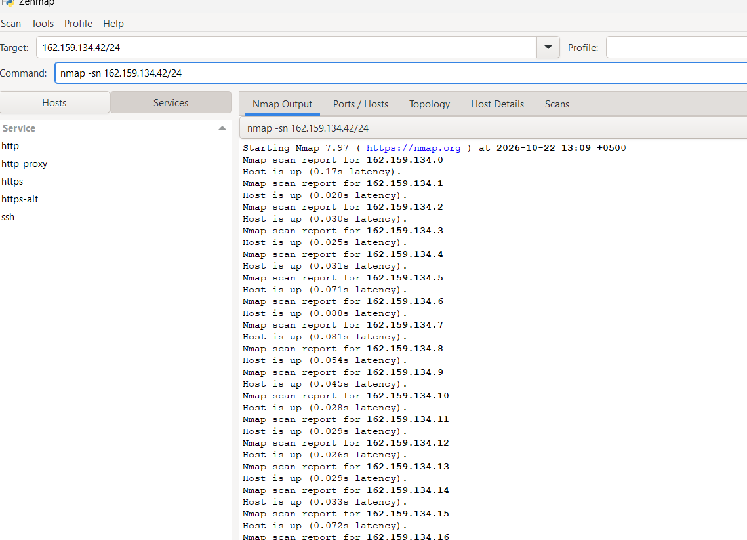
Active host Discovery
CYBERSECURITY • SEMESTER 5 13 / 21

Slide 21
Example scan: reason from evidence
• Illustrative output: 22/tcp open ssh OpenSSH 8.x
• 80/tcp open http Apache httpd 2.4.x
• 443/tcp filtered https
• What can be concluded? SSH and HTTP responded; HTTPS status is uncertain.
• What cannot? Whether passwords are weak, software is unpatched or data is exposed.
CYBERSECURITY • SEMESTER 5 14 / 21

Slide 22
Scanning methodology and controls
• Define IPs, ports, schedule, scan rate and stop conditions before scanning.
• Start with a narrow port set and conservative timing; avoid broad intrusive scans.
• Monitor target stability and coordinate with system owners.
• Retain commands, timestamps, results and exceptions for reproducibility.
• Never interpret lack of response as proof that an asset does not exist.
Plan first → scan carefully → monitor impact → record everything → do not over-interpret missing responses.
CYBERSECURITY • SEMESTER 5 15 / 21

Slide 23
From exposure to vulnerability
• An open port is an exposure, not automatically a vulnerability.
• A banner/version string is a clue, not reliable proof of an affected build.
• Consult vendor advisories and CVE entries for affected versions and prerequisites.
• Verify configuration, patch/backport status and compensating controls.
• Rank by exploitability, exposure, business impact and confidence.
Easy flow :Open port→ Identify service→ Check version→ Find relevant CVE/advisory→ Verify patch and configuration→ Assess impact→ Assign priority So the key message is:Scanning finds possible exposure; vulnerability assessment determines whether that exposure creates a real security weakness.
CYBERSECURITY • SEMESTER 5 16 / 21

Slide 24
Common defensive findings
• Unnecessary exposed management interfaces → restrict access or disable service.
• Outdated software → patch using tested change management.
• Weak TLS configuration → harden protocols and certificates.
• Unexpected public DNS records → review asset inventory and publishing processes.
• Overly broad firewall rules → apply least privilege and segmentation.
Unneeded service → disable/restrict it
Old software → patch it
Weak encryption → harden TLS
Unknown DNS entry → investigate/remove it
Firewall too open → restrict and segment
CYBERSECURITY • SEMESTER 5 17 / 21

Slide 25
Case study: university department
• An authorized scan shows TCP 22 and 80 open on a lab web server.
• A public DNS record points to an old departmental hostname.
• The HTTP banner suggests an older server release.
• Task: classify observations, propose verification steps and prioritize one control.
• Discuss why banner age alone cannot confirm a CVE.
CYBERSECURITY • SEMESTER 5 18 / 21

Slide 26
Case study: university department
Observation: Ports 22 and 80 open
Meaning: exposed services
Observation: old DNS hostname
Meaning: possible stale asset
Observation: old HTTP banner
Meaning: possible outdated software
Final conclusion:
These are findings that need verification; none of them alone proves compromise or a confirmed vulnerability.
CYBERSECURITY • SEMESTER 5 18 / 21

Slide 27
10-minute guided lab
• Minutes 0–2: confirm lab scope and record target IP.
• Minutes 2–4: run nmap -sT -p 22,80,443 LAB_IP.
• Minutes 4–6: run nmap -sV --version-light -p 22,80,443 LAB_IP.
• Minutes 6–8: classify two observations and one possible weakness.
• Minutes 8–10: write one verification step and one defensive recommendation.
•.
CYBERSECURITY • SEMESTER 5 19 / 21

Slide 28
Assessment questions
• 1. Why is passive reconnaissance not necessarily risk-free?
• 2. Contrast open, closed and filtered port states.
• 3. How can a CDN or reverse proxy distort attribution?
• 4. Why is an Nmap version banner insufficient to confirm a CVE?
• 5. Design a minimal-impact scanning plan for a campus lab subnet.
CYBERSECURITY • SEMESTER 5 20 / 21

Slide 29
Assessment questions
• Here are simple but strong answers you can use with 5th-semester students:
Why is passive reconnaissance not necessarily risk-free?
Passive reconnaissance avoids directly probing the target, but it can still create risks. Information may be outdated, misleading, sensitive, or collected in ways that raise privacy concerns. Also, relying on public information alone can lead to incorrect conclusions.
Contrast open, closed and filtered port states.
  Open: A service is actively accepting connections on that port.
  Closed: The host is reachable, but no service is listening on that port.
  Filtered: The scanner cannot clearly determine the state because a firewall or another security device is blocking or dropping the probes.
How can a CDN or reverse proxy distort attribution?
A CDN or reverse proxy can hide the real origin server. The IP address you discover may belong to Cloudflare, Azure, AWS, or another provider rather than the actual organization.
Example:
If university.edu resolves to a Cloudflare IP, scanning that IP may reveal Cloudflare infrastructure instead of the university's actual server.
So:
Observed IP ≠ automatically the organization’s own server.
Why is an Nmap version banner insufficient to confirm a CVE?
Because the banner may not accurately represent the exact software build or patch level.
CYBERSECURITY • SEMESTER 5 20 / 21

Slide 30
Summary & further reading
• Reconnaissance builds an evidence-based asset picture; scanning characterizes reachable services.
• Scope, accuracy, repeatability and defensive interpretation matter more than scan volume.
• Nmap Reference Guide: nmap.org/book/man.html
• MITRE ATT&CK Reconnaissance: attack.mitre.org/tactics/TA0043/
• NIST NVD: nvd.nist.gov | CVE Program: cve.org
CYBERSECURITY • SEMESTER 5 21 / 21

